Slide 1
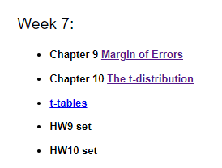
Homework
Answer the following Confidence Interval questions based on:
https://web.stat.tamu.edu/~suhasini/teaching301/teaching301_2019.html
See Week 7 Materials

Slide 2
Homework
When I take a sample with sample size 50, the sample distribution (ie. not the sampling distribution) will be a normal distribution based on central limit theorem.
When do you use the t-distribution and when do you use the normal distribution when calculating confidence intervals for the mean?
When the number of samples approaches a large number, we can use the normal distribution instead of the t-distribution. What would you consider as the number to do this?
When using the t-distribution, we have to determine the degrees of freedom. What is the degrees of freedom if I have 19 samples?

Slide 3
This statement is false. The central limit theorem states that given a sufficiently large sample size (n ≥ 30), the sampling distribution will approximate a normal distribution.
The only difference between utilising a normal distribution and t distribution is the latter is used when the standard deviation is unknown or sample size is small or both.
The number is at least 30.
If you have 19 samples, you would use a t distribution with 18 degrees of freedom.

